Slide 1
Mechatronic Machine Design (MMD)
Exercise 4

Slide 2

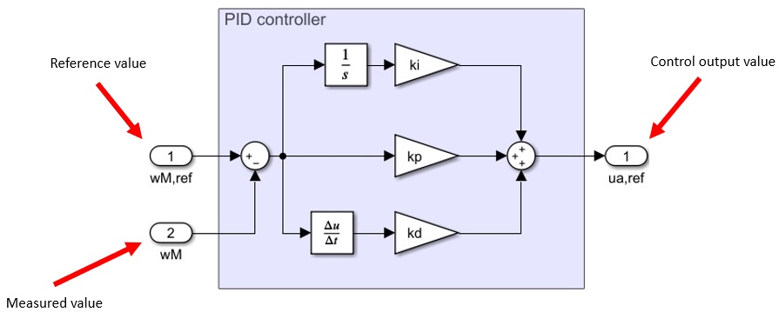


Task 1 (PID controller)
a) Check the Wikipedia article about PID controllers
b) Make your own PID controller in Simulink (example below, you can copy the design in Simulink! )
(Don’t use the ready-made PID block in Simulink Library! )
?

Slide 3
Task 2 (Anti-windup)
Anti-windup for PID controller
Purpose is to limit the accumulation of the integral term
(Note that the controller shown below lacks the D term)

Slide 4
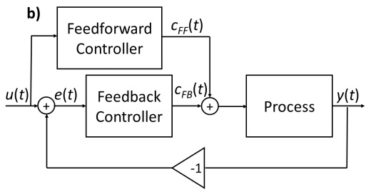
Task 3 (Feedforward)
Check lecture slides for a Simulink example (slide 23)
Note that the lecture example doesn’t feature anti-windup!
The feedforward signal must be added to the PID output signal before the saturation block of the anti-windup

Slide 5
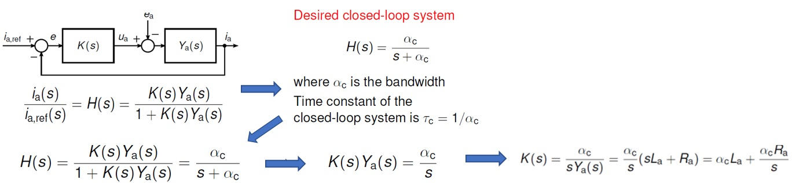

Task 4 (IMC, internal model control)
No need to use Matlab
Solve symbolically, no numerical values
a) $y(t)=\left[K_{p}e(t)\right]+\left[K_{i}\int{e(t)}dt \right]+\left[K_{d}∗\frac{de(t)}{dt}\right]$ -> Laplace transform, and solve G(s) = Y(s)/E(s)
b) Leave derivative term out

Slide 6
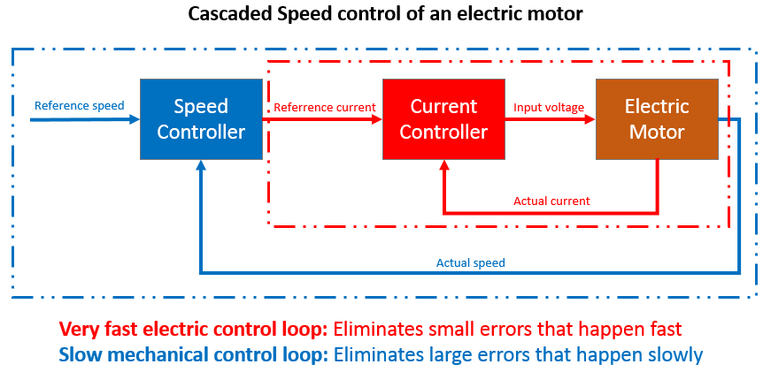
Task 5 (Elevator position control)
Position and speed control
Example below (NOTE: speed and current controller in this example, not position and speed!)

